Slide 1

3 SECURITY RISKS OF C++
Common Vulnerabilities and Prevention Techniques

Slide 2
Importance/How it’s Used
Direct memory access
Widely used in critical systems
Secure software development
Security testing

Slide 3
1- Buffer Overflow
One of the most common security concerns with C++
Ranked as the most dangerous software weakness
Caused by not having built-in boundary check features in C++
Writing outside our allocated memory can cause program crashes

Slide 4
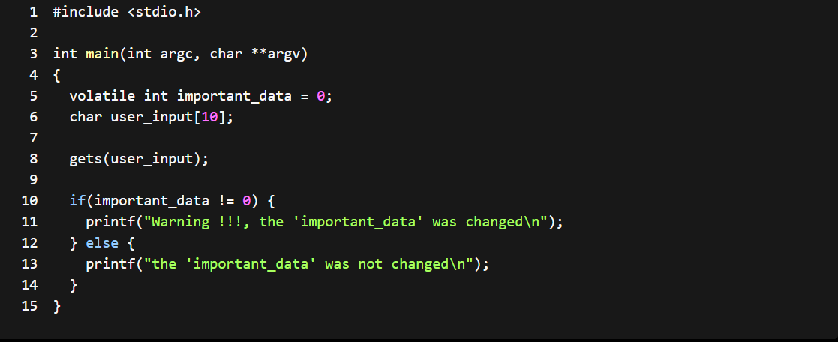

Slide 5
Vulnerability
Vulnerable to a buffer overflow attack if the user enters a string longer than the length of the user_input array.

Slide 6
Prevention Techniques
Use stack canaries to secure data
Data Execution Prevention (DEP)
Good coding practices:
Bound Checking
Avoid standard library functions like strcpy, scanf, printf, and get
Replace them with equivalent secure functions, like fgets.

Slide 7
2- Integer Overflow and Underflow
Integer overflow is when the value we’re trying to store in an integer variable exceeds the maximum value an integer can hold
Integer underflow occurs when this value is less than the minimum value an integer can hold
12th most dangerous software weakness
Integer overflow and underflow can lead to a buffer overflow vulnerability

Slide 8
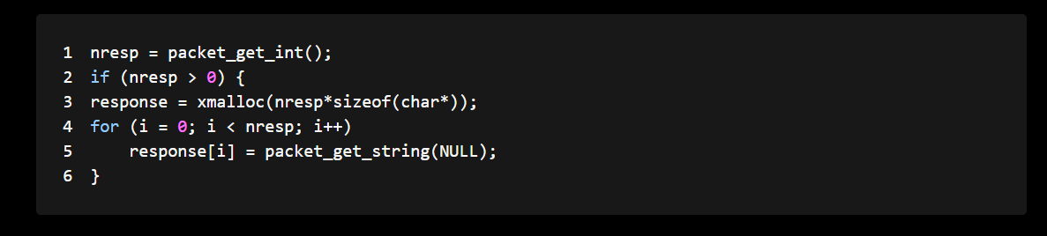

Slide 9
Vulnerability
This code represents an integer overflow vulnerability
While the code checks for a zero value, it’s possible to have a zero-memory allocation if the input nresp equals 1073741824
Multiplying this value with four (size of char pointer) causes the variable to overflow, and xmalloc(nresp*sizeof(char*)) allocates a buffer of size 0

Slide 10
Prevention Techniques
Range Checking to protect against overflow or wrapping of the variable value

Slide 11
3- Pointer Initialization
We can expose a lot of data using a pointer that’s not initialized as a pointer to a memory location or function
If the uninitialized pointer points to a memory location:
Cause the program to read or write to an unexpected memory location
If it points to a function, it can cause the unintentional execution of an arbitrary function

Slide 12
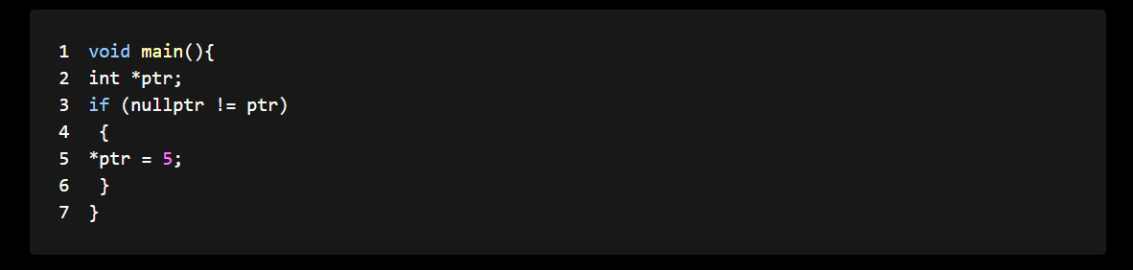

Slide 13
Vulnerability
As we can see, the pointer is left uninitialized, which means that a random value is assigned to it, and the check will pass, as it may be a non-null value
Pointers are also vulnerable to null pointer dereferencing attacks, which can lead to program reliability issues
An attacker can take advantage of this by enforcing a null pointer dereference:
Can bypass some security checks or reveal debugging information

Slide 14
Prevention Techniques
Avoid using a Pointer and use references instead
Use smart pointers instead of raw pointers, if you really have to

Slide 15
Key Notes
C++ has a variety of vulnerabilities
Developers must be aware of when writing code
As developers, it’s our responsibility to implement security techniques

Slide 16
Check It Out
https://github.com/raamishkhan99/cpp-security-risks.git

